Slide 1


Optum EMR/PM Software Introduction

Slide 2

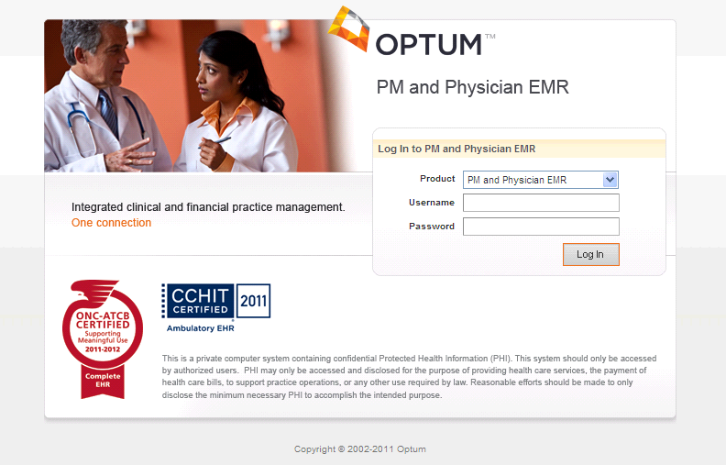
Introducing

Slide 3
About
Fully integrated, CCHIT®-certified, web-based EHR/PM software
Backed by 200,000 doctors, 3,500 hospitals and 1,500 insurer relationships
This is a software you might actually encounter in the workplace!

Slide 4
Integrated Administrative and Clinical Experience
Entering Patient Demographic and Insurance Information
Setting up appointments
Entering coding, billing, and payment information
Charting patient encounters, including recording vital signs, patient interview data
Reviewing doctor’s notes
Coding diagnosis and treatment
Front Office Activities
Back Office Activities

Slide 5



How to Access
Purchase your textbook and go to the Point.lww.com
Create an account, and register your title using the code provided in the front
Notes:
Students will access thePoint as they’ve done previously and then the click a button to get their personal Optum login
This is access to just the EHR and cases; if book adopted, students would have access to the entire suite of online resources in addition to Optum and Cases.

Slide 6
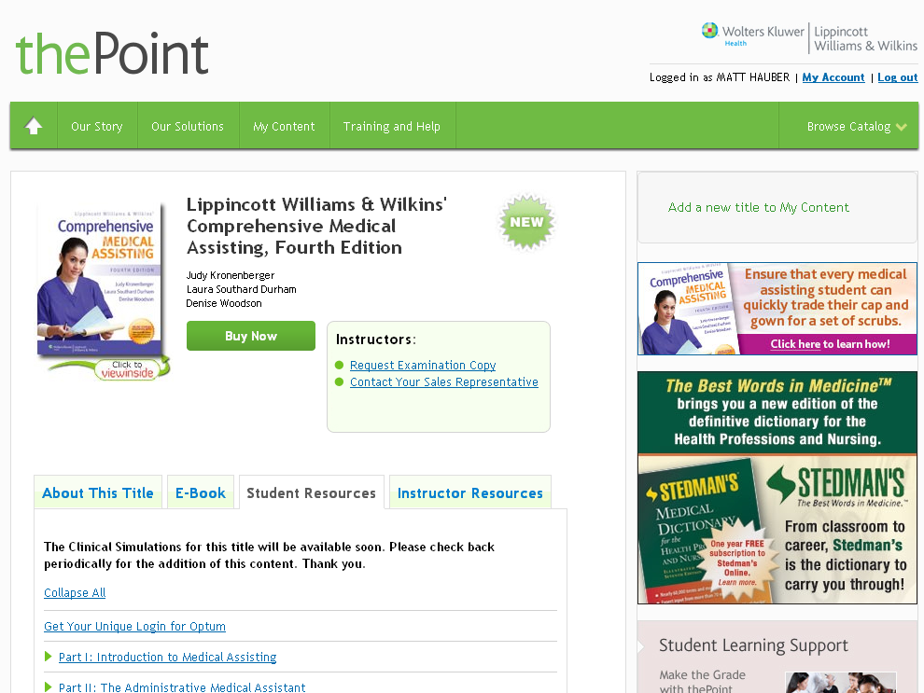
How to Access
Log in and proceed to the book site
Download the “Getting Started” guide and click the link “Get Your Unique Login for Optum”

Slide 7
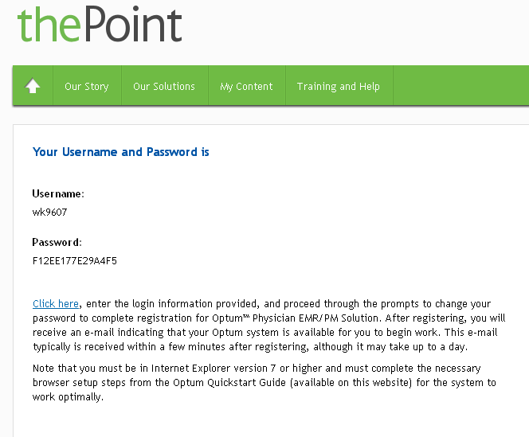
User Experience
An End User License Agreement will pop up
Upon accepting EULA, student receives unique Optum login and link to the site
Make sure you complete the browser setup steps in Getting Started before going to the Optum site.
Notes:
Student must read an End User License Agreement, click to accept, and then they get their user name and password and then click on the link to https://training.CareTracker.com. They can get to Optum from thePoint or just go directly to the URL from their computer.

Slide 8
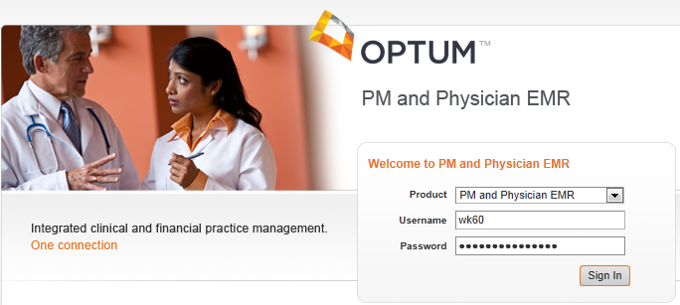
User Experience
Click the link and add the site to your favorites.
Enter login information provided
Notes:
Students will be prompted to create a new user name and password

Slide 9

User Experience
The first time you log in, you will be prompted to change your password. Do so.
Login is complete. You will receive an email when your company is ready to use.
Notes:
Students will have 2 years from date of initial login to access the software.
In future can go through thePoint to access CareTracker, or directly to www.CareTracker.com

Slide 10
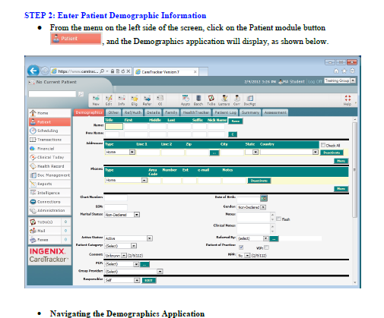
Case Studies
Case studies can be found as part of the student resources on the textbook’s site on thePoint.
Notes:
The software comes with a comprehensive set of core case studies that will walk students step by step through the key administrative and clinical functionality of CareTracker that Medical Assistants will use in the real word.
These cases place students in real-world scenarios, such as scheduling a patient appointment or recording vital signs, so students can build proficiency in an EHR/PM software environment.
The case studies are progressive, covering all activities from appointment scheduling to check in through check out. Completion of these case studies will provide thorough experience in CareTracker. Again, report printing instructions are built into the cases for handing in to instructors.
Provided as a downloadable and printable PDF from thePoint, the cases can be customized if there are certain skills and activities unique to your curriculum that need additional attention. Just let us know your needs and our Custom services department will work with you to create additional case studies.
Finally, these are adaptable to be as robust or simple as you need them to be, and can be perfectly fit into your existing curriculum.

